Slide 1
A Scout’s Life
Veer Pareek

Slide 2


Introduction
How would Data Analysis done by a NFL scout to find prospects?
NFL Next Gen Stats Database
Genetics vs. Dedication

Slide 3

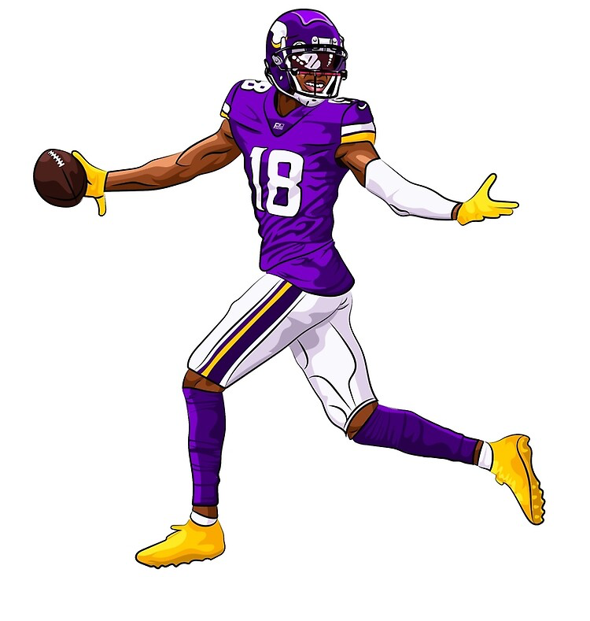
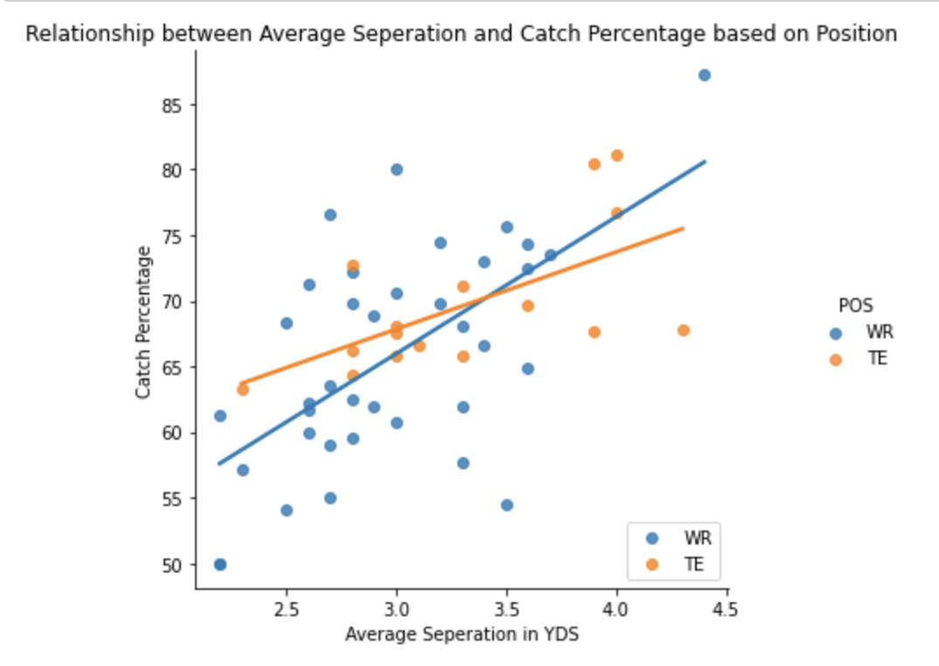
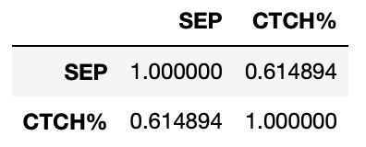
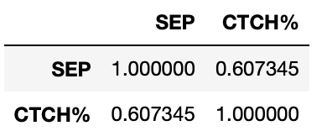
Descriptive Analytics Research Question
Height and Catch Percentage
How does the relationship between average separation and catch percentage change for different positions?
VS.

Slide 4
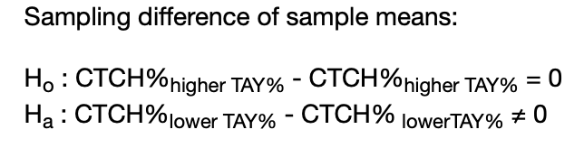
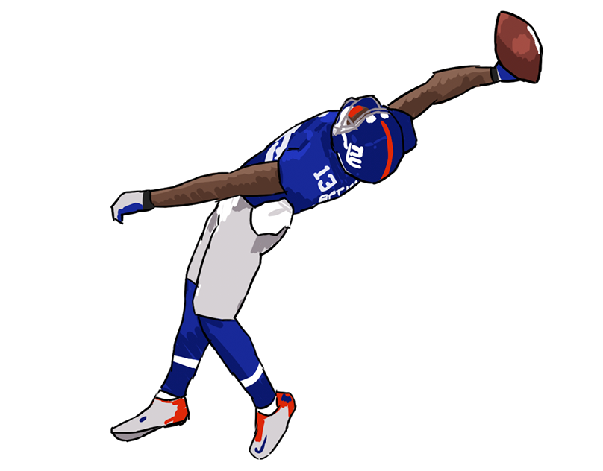

Inference Research Question
Is there sufficient evidence to suggest that there is an association between catch percentage and being a higher target receiver (generates > 18% of teams air yards) in all NFL receivers?

Slide 5

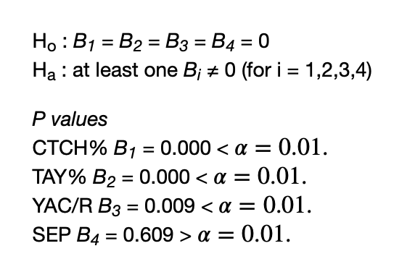
Linear Regression Research Question
Is there sufficient evidence to suggest that there is a linear relationship between Receiving yards and Catch %, Target Air Yards %, Yards after catch per Reception, and Average Separation in all NFL Receivers?

Slide 6
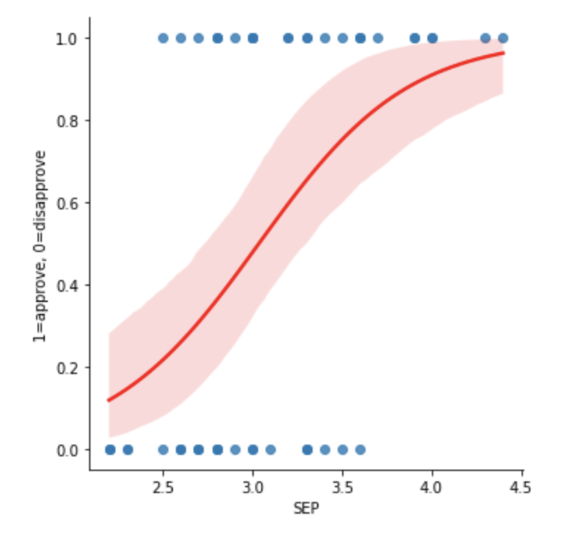
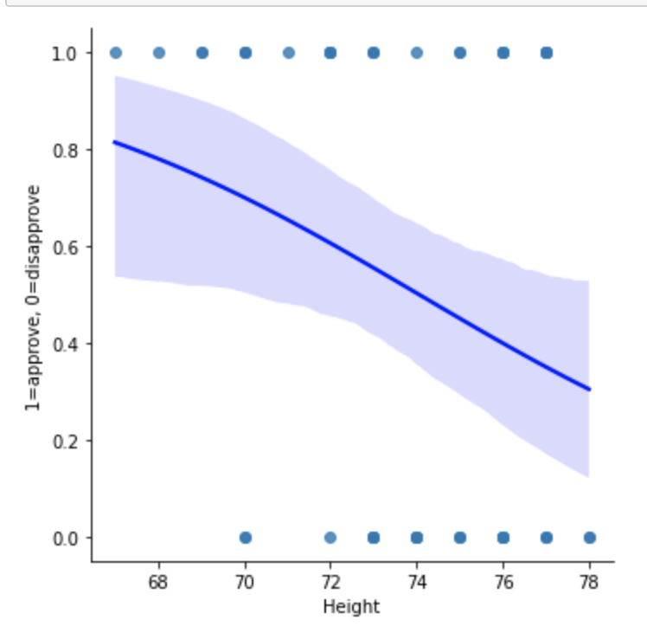
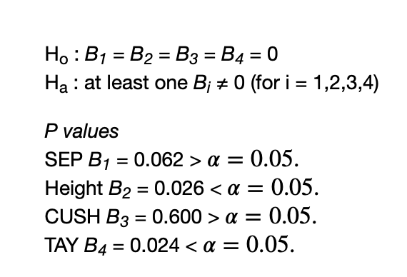
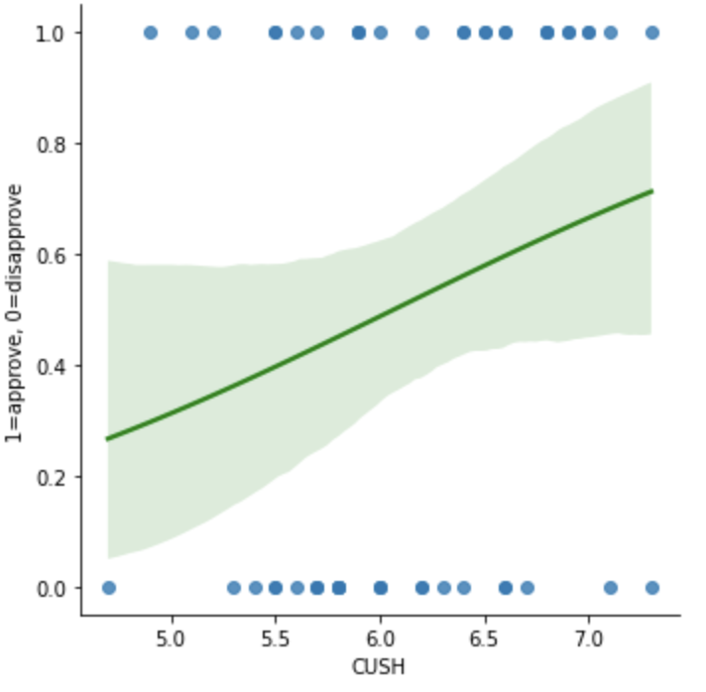
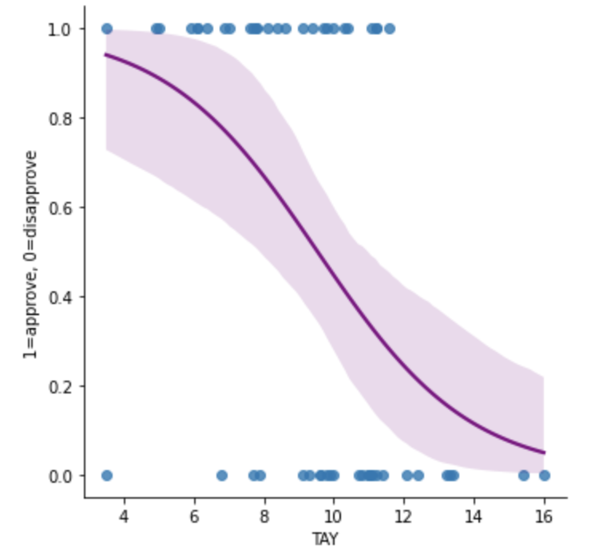
Logistic Regression Research Question
Is there a linear relationship between the log-odds of the success level of Catch % and Average Separation, Height, Average Cushion, and Targeted Air yards in ALL NFL Wide Receivers?

Slide 7
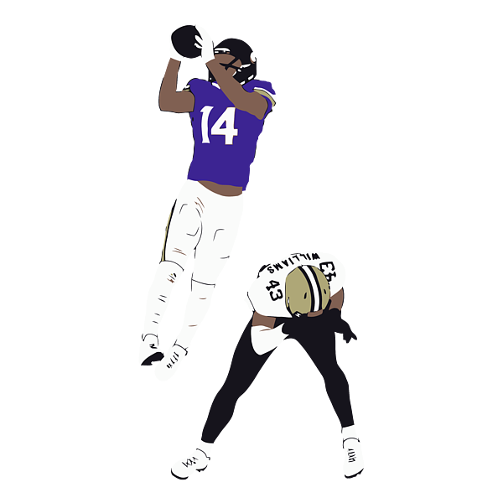
Conclusion
Summary
Future Work
Any Questions?

